Slide 1
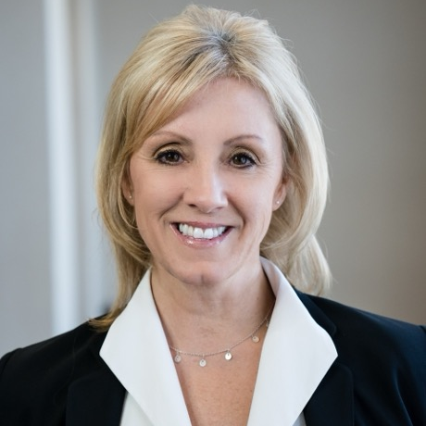
Shaney Walter Manager — Acceleration
Email
shaney.walter@thebridge.com
Location
Philadelphia, Pennsylvania
Mobile
(215) 350-7105
Shaney, a seasoned Supply Chain professional, joined The Bridge in June 2024 with 20+ years specializing in Healthcare Supply Chain optimization, transformation, and change management. Passionate about cultivating excellence, reliability, and continuous improvement.
EXPERIENCE
Industry Experience
Healthcare | Oil & Gas | Banking | Telecom | Contingent Workforce | Travel | Energy | Retail
Healthcare Consultant - Memorial Sloan Kettering Cancer Center, Intermountain Healthcare, Houston Methodist, UCHealth, Intalere, Oregon Health Sciences University
Led Supply Chain transformation initiatives across multiple organizations, focusing on roles assessment, diversity programs, procurement standardization, and policy development.
Managed the design and implementation of Supplier and Customer Relationship Management Programs, including business guidelines, scorecards, and governance policies.
Enhanced policies and procedures across Supply Chain functions to drive efficiency and ensure compliance with industry standards and non-Supply Chain policies.
Developed enterprise procurement best practices integrating rigorous supplier and transaction risk assessment protocols alongside structured spend guidelines to optimize sourcing decisions and mitigate operational risks effectively.
Developed and implemented standard operating procedures and training for the Contracting Department's Sourcing Methodology.
Led cross-functional teams in establishing best practices, policies, and methodologies using advanced project and change management practices.
Created educational resources such as an interactive End-to-End Supply Chain PDF and internal websites for knowledge sharing.
Initiated programs to promote adoption of Supply Chain Transformation through newsletters and town hall presentations.
BACKGROUND
Functional Skills
Supply Chain Process Optimization, Strategic planning, Cross-Functional Collaboration,
Change Management, Leadership and Team Development, Governance, Problem Solving and Decision Making, Communication Planning and Execution, Continuous Improvement
Qualifications
Consulting leader with a proven track record of driving efficiency, enhancing quality, and optimizing processes across healthcare supply chain operations. Expertise in strategic planning, cross-functional collaboration, change management, and implementing innovative solutions to achieve operational excellence and industry standards.

Slide 2

Email
shaney.walter@thebridge.com
Location
Philadelphia, Pennsylvania
Mobile
(215) 350-7105
Shaney, a seasoned Supply Chain professional, joined The Bridge in June 2024 with 20+ years specializing in Healthcare Supply Chain optimization, transformation, and change management. Passionate about cultivating excellence, reliability, and continuous improvement.
Shaney Walter Manager
Acceleration

Slide 3










 | USE OVER DARK BACKGROUND | USE OVER LIGHT BACKGROUND
STRATEGY & ADVISORY
DATA & AI
EXPERIENCES
CLOUD & PRODUCT
ACCELERATION

